Slide 1
Interactive METRO Map Editing
Written by :
Yu-Shuen Wang and Wan-Yu Peng
Presented by:
Dilip Dwarakanath

Slide 2
Introduction
Metro maps have become important tools as the number of metro lines in cities increases.
These maps are typically used by passengers to orient themselves in a complex traffic network.
Unlike general maps, metro maps display network topology rather than exact geography.
Such information is helpful to passengers, who instantly need to know which station to get on or off a train.

Slide 3
When a metro network is developed in a city, cartographers have to redesign the map for passengers.
However, designing a metro map is time-consuming and requires expert skills.
Although several automatic layout algorithms have been presented to reduce the burden of cartographers, these algorithms may not satisfy aesthetic and readability requirements.
Given that fully automatic methods are difficult to control, cartographers who attempt to modify a metro map still have to manipulate most station positions.
Consequently, an interactive interface that allows cartographers or even non-professionals to easily design a metro map is essential.

Slide 4
Interactive Metro Map Editing
In this paper, we present a unique user interface to create and edit metro maps.
To be able to do this effectively, we take into account different affecting factors:
  Interactivity
  Intelligence
  Stability
  Effectiveness
  The authors implement these features in their software by using curvilinear and octilinear optimization techniques.

Slide 5
Octilinear Layout Optimization
Octilinear Direction: The essential requirement of an octilinear layout is maintaining edges to extend in the vertical, horizontal, or diagonal directions.
This property provides simple and orderly topological representations to enable passengers to navigate by themselves.
To achieve this requirement, we rotate each edge {i,j} by the angle φ𝛿(i,j) to an octilinear direction:
  Where φ is the angle of the edge.
  And 𝛿 is the is the closest octilinear angle to φ(i,j)

Slide 6
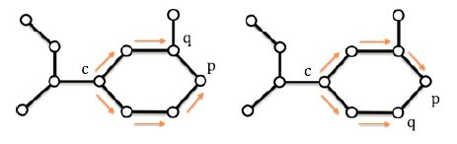
Straightness
Each metro line should be straight to allow users to trace stations without frequently switching attention when reading the map.
Consequently, our system ensures that neighboring edges will have similar directions.
This constraint is not added to the edges adjacent to a junction because the intersecting metro routes are expected to extend in different directions.

Slide 7
Rotation Conservation
In addition to octilinear directions and straight lines, the vertical and horizontal components of a curvilinear line should be maintained when edges on the line are rotated.
Given that our objective is to approximate the octilinear layout to its curvilinear version, our system attempts to conserve rotation when computing for octilinear edge angles.
That is, when some edges on a line rotate clockwise, others will rotate counterclockwise, and the sum of edge rotation is expected to approximate zero.
This strategy prevents the global shape of an octilinear layout from deviating from that of its curvilinear version.

Slide 8
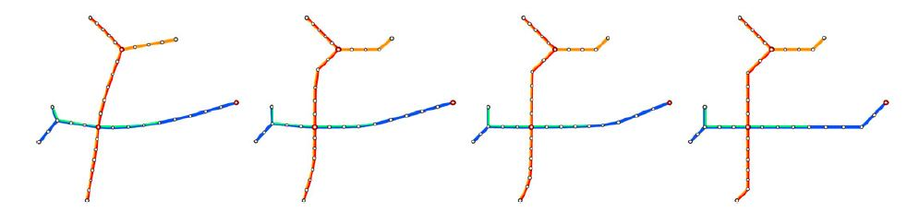

Slide 9
Equal Edge Lengths
A metro map with evenly spaced nodes has an orderly and aesthetic appearance.
This kind of map also allows users to trace stations without frequently switching attention.
Equal length edges are far more useful than edges drawn with a scale ratio.

Slide 10
Intersection Prevention and Positional Constraints
Similar to curvilinear layout optimization, nodes and edges in an octilinear layout should also be sufficiently far to prevent unwanted intersections.
Otherwise, users may be misled and may attempt to switch trains at a wrong station.
Every node should be positioned precisely where it should be.
This node should in actuality accurately represent the geographic location of a given station or location.
Nodes cannot be arbitrarily placed.

Slide 11
Labelling Station Names
Our system computes for the position of each station name once the octilinear layout is obtained. The name is placed around the station and can extend in one of the octilinear directions.
Three requirements should be satisfied when placing these labels:
  1) extending neighboring station names in the same direction,
  2) preferentially positioning its name on either side of a station,
  3)preventing occlusion of station names.
The first requirement allows users to read station names without frequently switching attention.
The latter two constraints ensure that all characters can be recognized easily

Slide 12
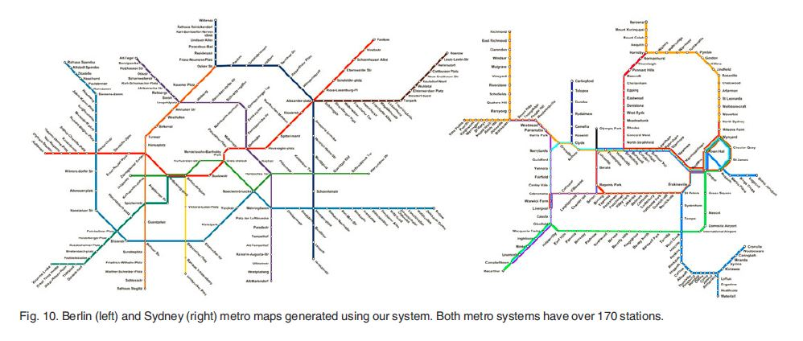
Results

Slide 13
                THANK YOU

